Slide 1
Restaurant Analysis
Yash Pawar

Slide 2
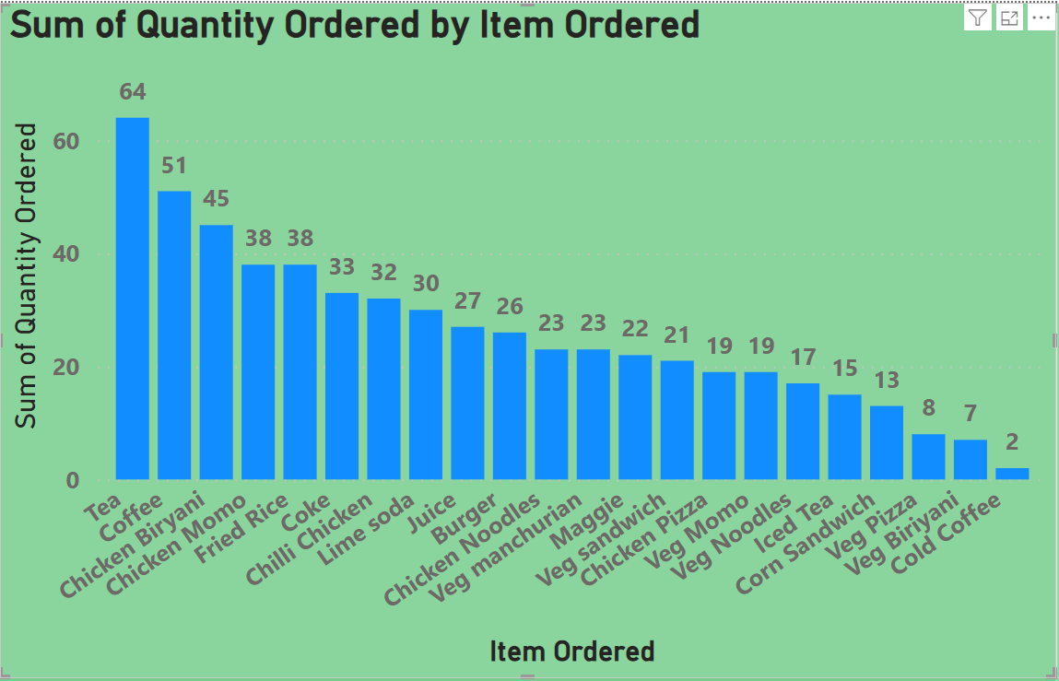
Which item is sold the most and which item is sold the least? Bar graph indicates, Tea is the most popular item with 64 units sold, indicating strong customer demand, On the other hand, cold coffee is the least popular item with only 2 units sold, suggesting it does not resonate well with the current customer base.

Slide 3
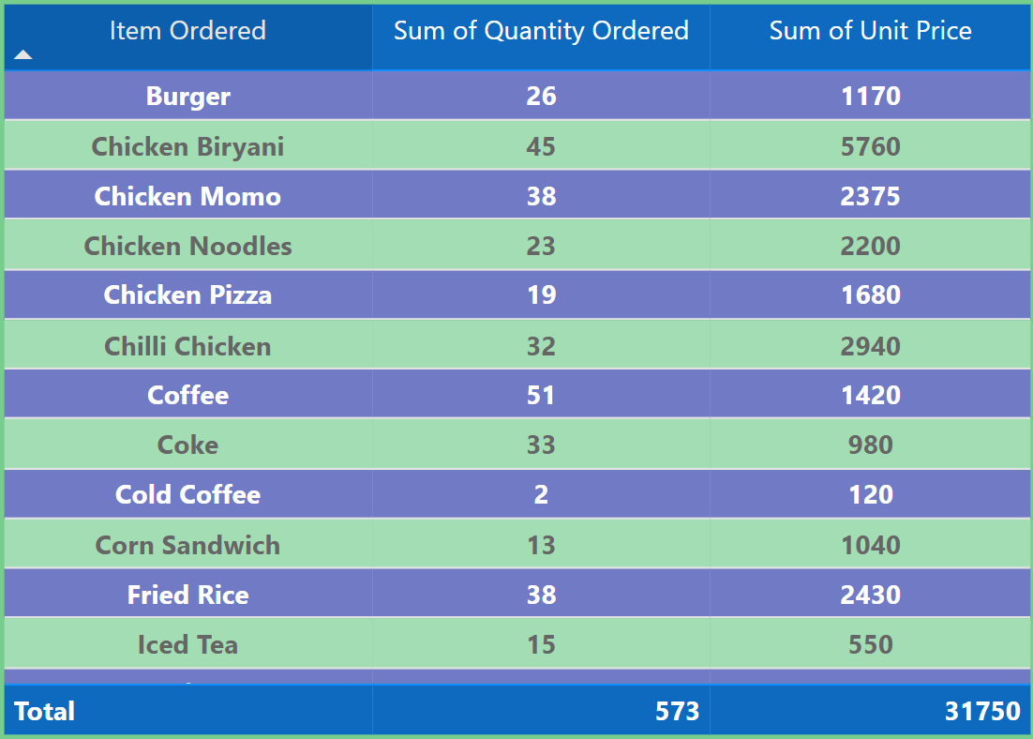
Are more units ordered against lower-priced items or higher-priced items in a single order? Lower Priced Items :- Tea having higher quantities ordered Higher Priced Items:- Chicken biryani have lower quantities ordered

Slide 4
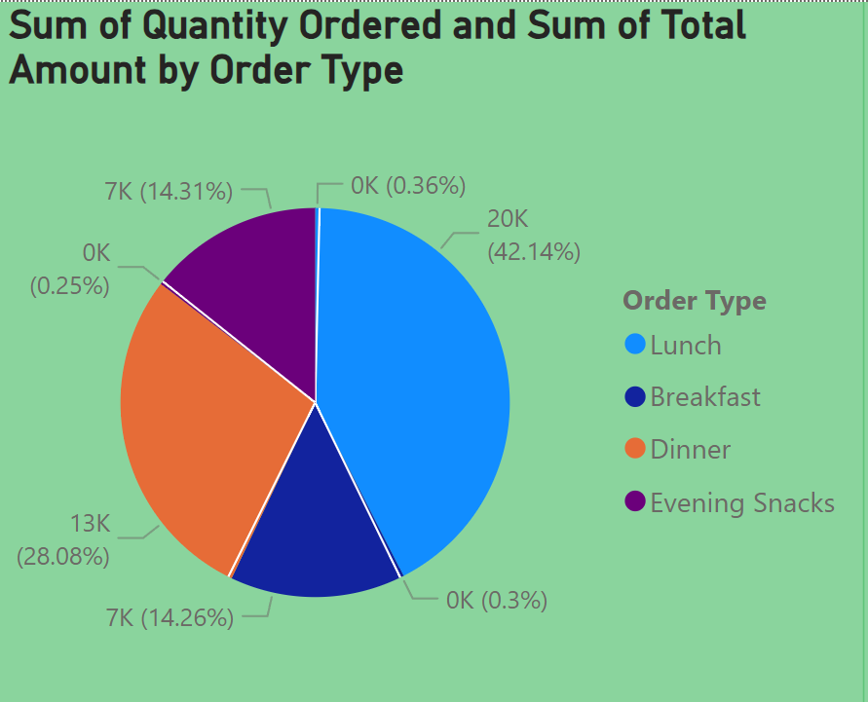
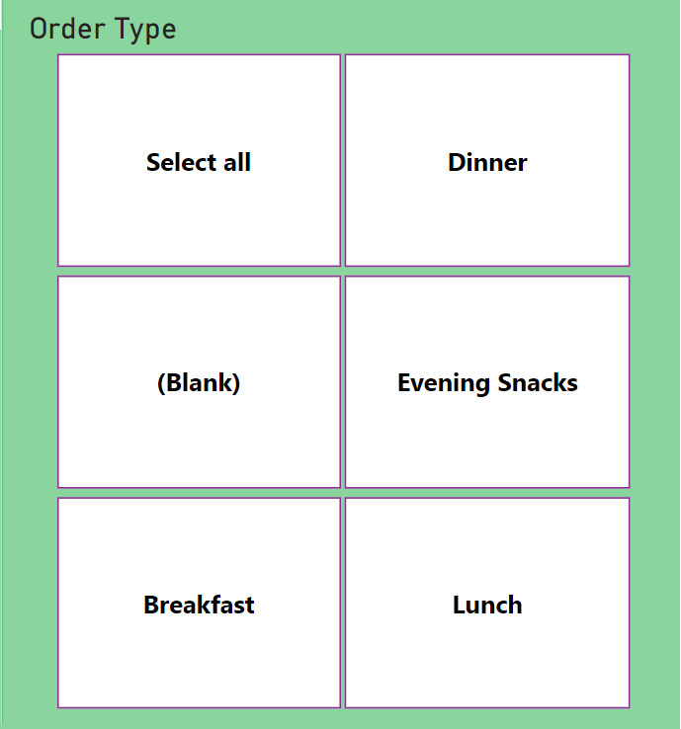
What items are sold more and what items are sold less in what type of meal? Breakfast:- In breakfast tea is sold more and iced tea is sold less Lunch :- In lunch chicken biryani sold most and veg momos sold less Evening snacks:-In evening snacks coffe sold most and cold coffe sold less Dinner:- In dinner lime soda sold most and Fried rice sold less

Slide 5
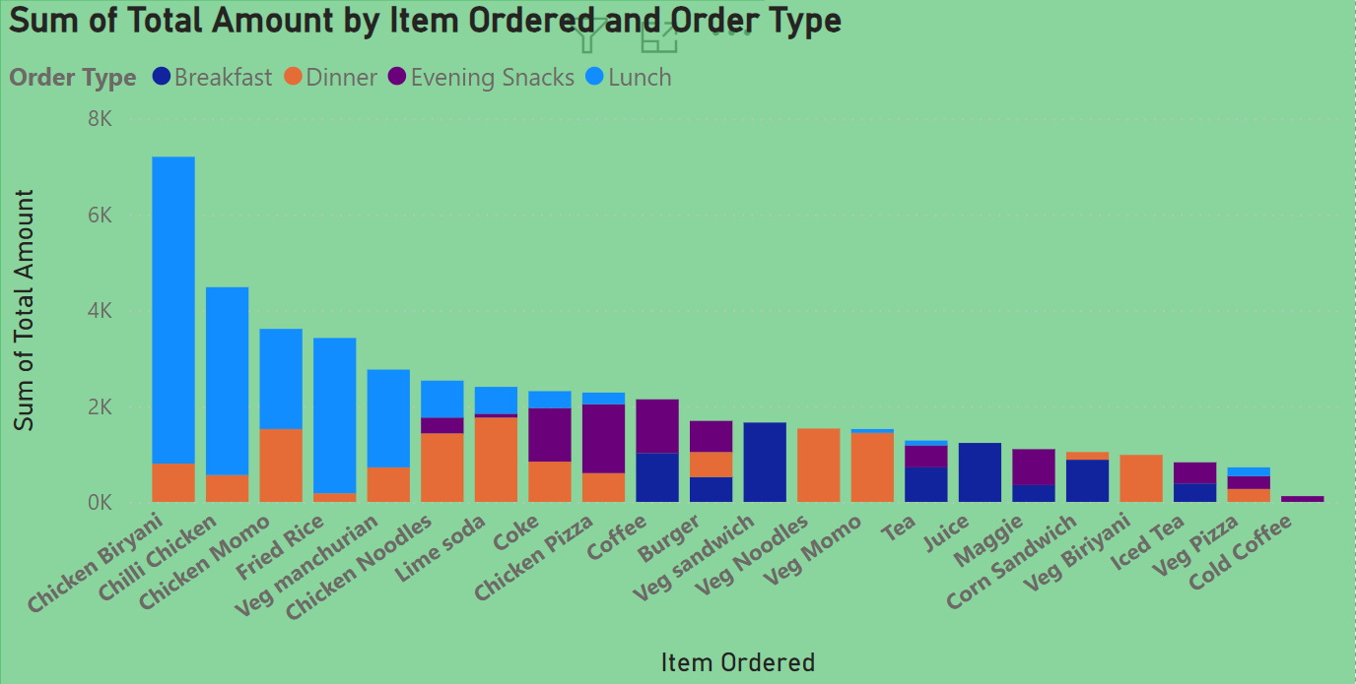
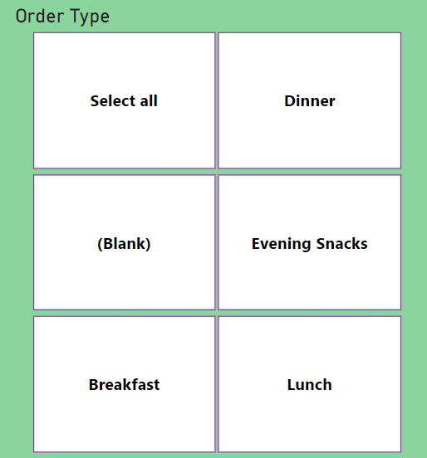
Sale of which items in what type of meal generate a greater amount of sales? Sale of chicken Biryani is greater in Lunch sale of chicken pizza is greater in evening snacks sale of lime soda is greater in dinner sale of veg sandwich is greater in breakfast

Slide 6
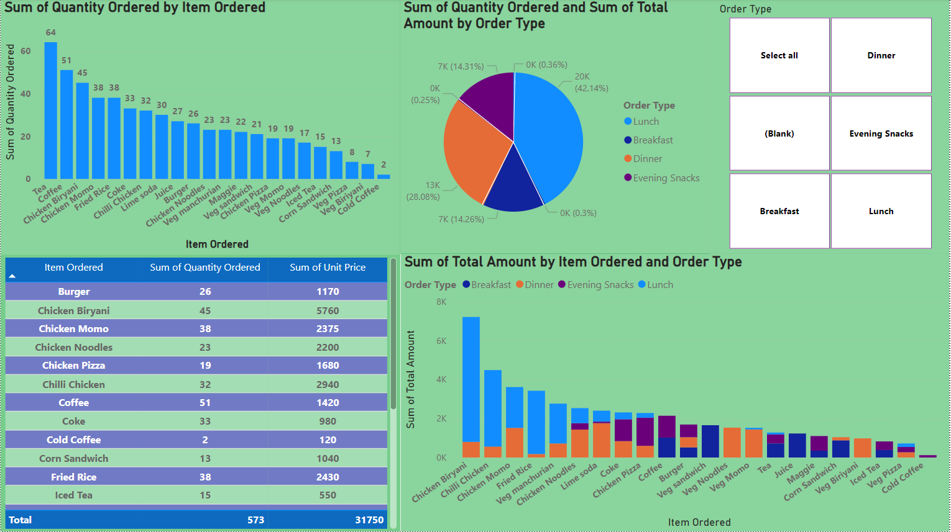
Dashboard

Slide 7
Q5) should the company offering all items at different times of the day?
1.Breakfast:- In Breakfast the tea and coffe are most popular.
2.Lunch:- Focus on chicken biryani and fried rice during lunch. Veg biryani could be offered in smaller quantities or as an optional item especially if it consistently underperform
Dinner :- chicken biryani should be main focus for dinner
Evening snacks:- Iced tea and Veg pizza can be replaced with more popular snack items to improve profit.

Slide 8
Actionable insights from the analysis for cost-cutting and improving the profit
Cost cutting insights:-
RecommandatioLow selling items:-
In breakfast Iced tea ,Maggie ,Corn sandwich have low sales compared to other amounts.
In Evening snacks Lime soda have very less sale.
n:- By reducing the availability of Items having low sales to cut costs
Profit Improving insights:-
Lunch:-Veg Momo,Chicken Pizza,chilli chicken,chicken biryani
Dinner:- Fried rice, chicken biryani,chicken noodles .
Recommendation:- By focusing on these high selling items for better profit
Also By Increasing some quantity is also a good idea for better profit

Slide 9
Thank You

